Slide 1
Term Deposit Prediction
TEAM 5
Manaswini Rayappureddi
Sai Kalyana Pranitha Buddiga
Venkat Sai
Siva K
Pei ju

Slide 2
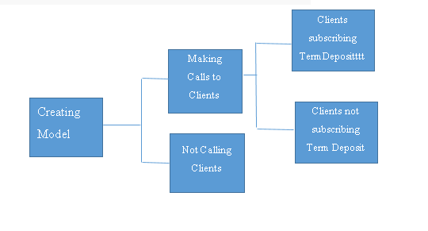
Business Problem
Goal: To design a data driven approach to predict if the client will subscribe for a term deposit
The campaign team can target the right clients to maximize the number of term deposits
Predicted Yes
Predicted No

Slide 3
Data Cleaning
Validating the data type
Data Inconsistency
Treating Missing Values
Standardizing variable
Data Division
Training
Validation
Testing

Slide 4
Classification Models
Performed the following Modelling techniques in order to predict the target variable
Nominal Logistic
Clustering
Neural Networks
Decision Tree Analysis
Discriminant analysis
Ensemble

Slide 5
Accuracy Table
Model | True Negative | False Positive | False Negative | True Positive | Correct Predictions | Accuracy
Discriminant Analysis | 3024 | 1235 | 215 | 526 | 3550 | 71%
Decision Tree | 2967 | 1292 | 208 | 533 | 350 | 70%
Neural Networks | 3530 | 729 | 291 | 450 | 3980 | 80%
Nominal Logistic | 3554 | 705 | 263 | 478 | 4032 | 81%
Ensemble | 2971 | 1288 | 209 | 532 | 3503 | 70%

Slide 7
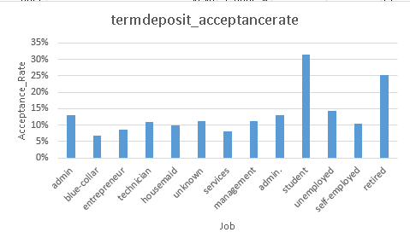
Recommendations
The bank can target more students as they have a high acceptance rate compared to clients who belong to other job categories

Slide 8
Recommendations continued
The bank can target more singles as they have a high acceptance rate compared to marital status of other clients
Acceptance

Slide 9

Can we depend on accuracy

Slide 10
Good Vs Bad clients
Benefit of Good Customers
Cost of Bad Customers
(Term deposit*Benefit of Good customers )– (Operating cost*cost of Bad Customers)

Slide 11
Thank you

